Slide 1
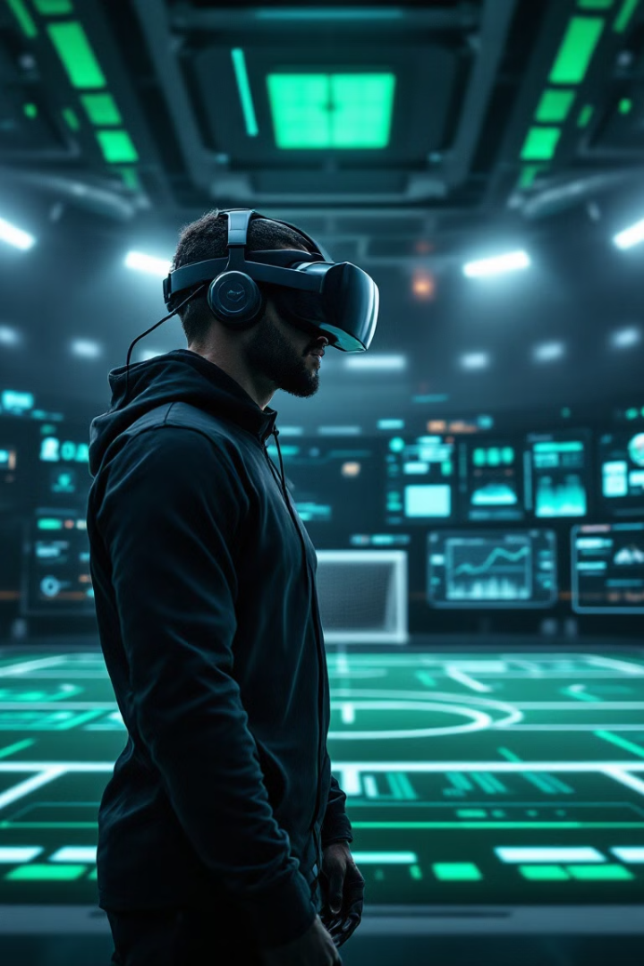
Revolutionizing Football Training with AI-Powered VR
DBX London is set to transform football training through an innovative AI-powered VR application. This project integrates cutting-edge technologies, including Artificial Intelligence, Digital Twin technology, and Virtual Reality, to provide unparalleled insights and training experiences. The application aims to enhance player development, improve decision-making skills, and provide comprehensive performance analysis, ultimately revolutionizing the way football is taught and played. This initiative promises to deliver a new era of player development and strategic insight.
By Data Software Technologies

Slide 2
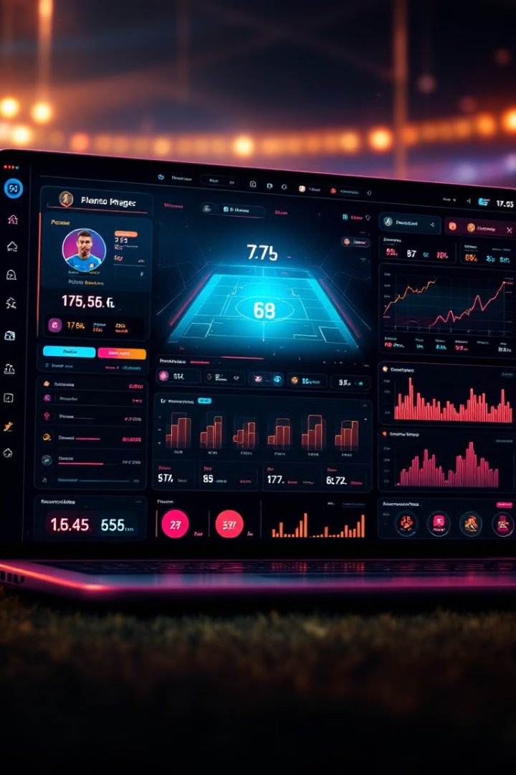



Project Objectives: A New Era of Football Training
AI-Powered Digital Twin
Predictive Analytics
Immersive VR Training
Create a virtual replica of real-world player performance, providing a detailed and dynamic model for analysis.
Optimize training programs using AI-driven insights, ensuring tailored and effective player development strategies.
Develop a VR simulation for skill-building, offering a realistic and engaging training environment.
Data Software Technologies

Slide 3
Key Applications & Their Transformative Purpose
VR Training Application
Mobile Application
Admin Portal (Web-Based)
Provides an immersive football training experience using AI-driven simulations and real-time feedback, enhancing skill development.
Enables players to track performance data, receive personalized training recommendations, and schedule sessions, fostering continuous improvement.
Allows coaches and admins to monitor player progress, adjust training plans, and analyze AI-driven insights, optimizing team strategies.
Data Software Technologies

Slide 4

Project Timeline & Phases: A Strategic Rollout
Phase 1: Data Collection
1
Focus on gathering comprehensive player data to build the foundation for the AI Digital Twin, laying the groundwork for future analysis.
2
Phase 2: AI Training Model
Develop the AI training model and VR simulation, creating the core of the immersive training experience and performance enhancement.
Phase 3: MR Deployment & Testing
3
Implement and rigorously test the Mixed Reality deployment in real matches, validating the effectiveness and impact of the training application.
Data Software Technologies

Slide 5
Cost Estimation: Strategic Investment in Innovation
AI Development & Software Engineering: $60,000
VR/MR Application Development: $60,000
Data Processing & AI Model Training: $30,000
Project Management, Testing & Quality Assurance: $30,000
Azure Cloud Server & Storage - Costs Based on Actuals
Data Software Technologies

Slide 6

Required Resources & Team Composition: Assembling the Dream Team
AI & ML Engineers
VR/MR Developers
Develop AI models, predictive analytics, and Digital Twin system.
Build immersive VR training simulations and Mixed Reality overlays.
Data Scientists
Process and analyze player movement data for AI insights.
Data Software Technologies

Slide 7
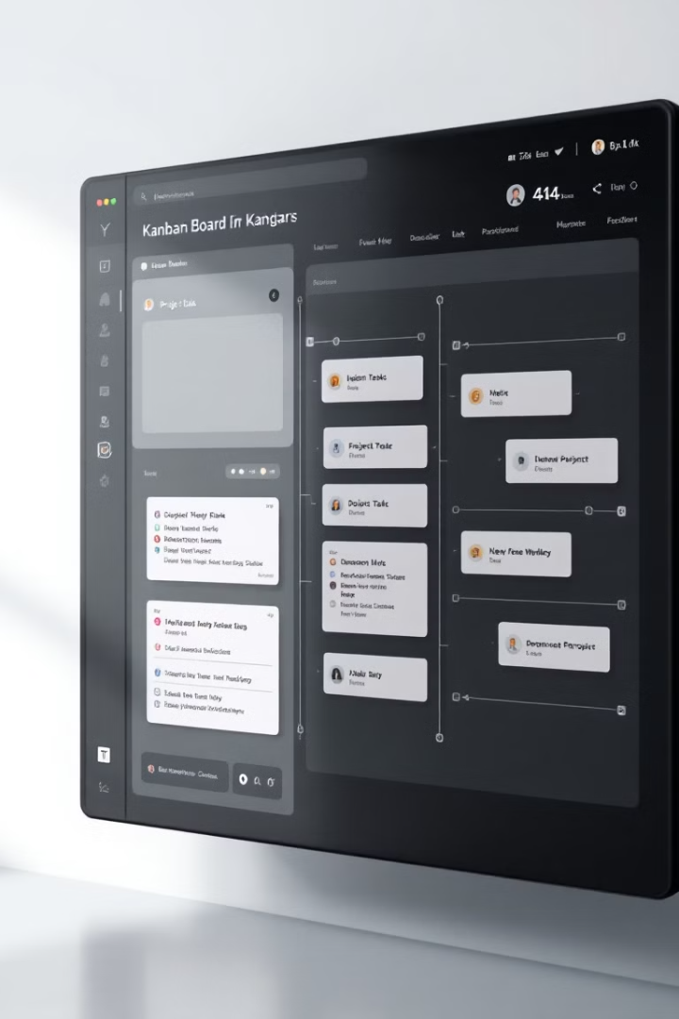



Agile Project Management & Tools: Ensuring Seamless Execution
Scrum Framework
Utilizing sprints, daily stand-ups, and retrospectives for iterative development and continuous improvement.
Azure DevOps
Leveraging cloud-based project management and deployment for streamlined processes and efficient resource allocation.
Demo Sessions
Conducting regular sessions for stakeholder review to ensure alignment and gather valuable feedback.
Data Software Technologies

Slide 8
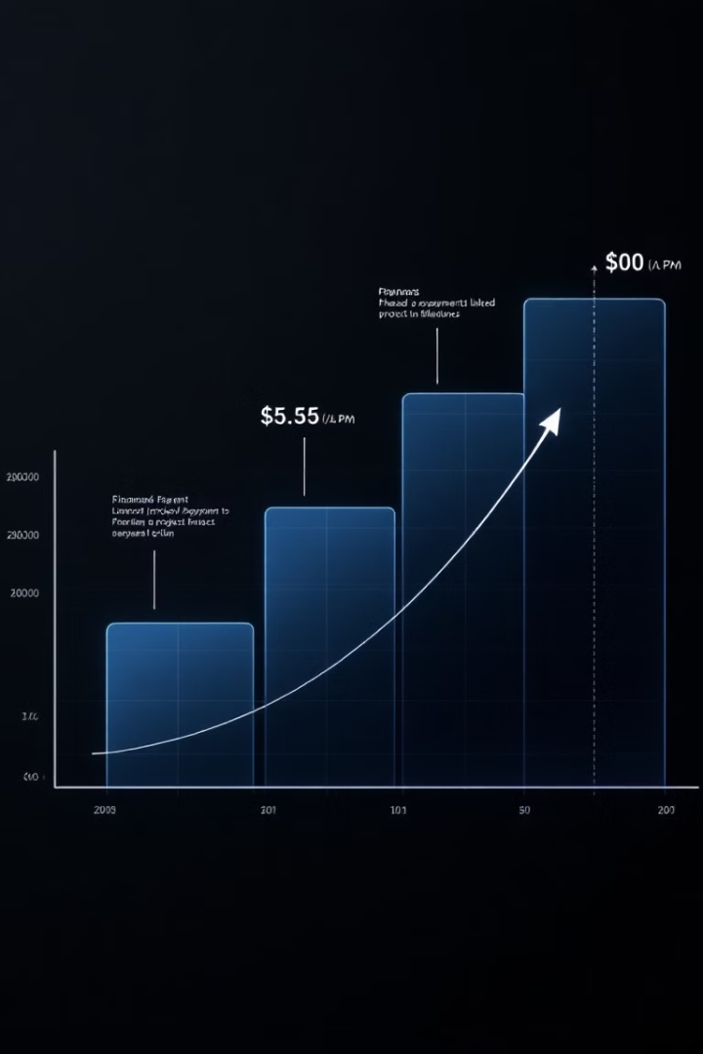
Payment Plan: Structured & Transparent Financial Strategy
1
Upfront Investment
2
Progress-Based Payments
20% on sign-up, securing commitment and resources.
10% upon architecture completion, rewarding key milestones. 10% per sprint completion (6 total sprints), aligning payments with tangible progress.
3
Final Payment
10% on go-live, incentivizing successful deployment.
Data Software Technologies

Slide 9
Risk Management & Mitigation: Proactive Strategies
1
AI Model Inaccuracy
2
Data Delays
3
Data Privacy
Proactive risk management ensures project success. Rigorous testing with diverse datasets will mitigate AI model inaccuracies. Regular progress tracking via Agile sprints addresses potential data collection and training delays. Ensuring compliance with GDPR and employing encrypted storage alleviate sensitive player data privacy concerns.
Data Software Technologies

Slide 10




Next Steps: Charting the Course Forward
Detailed Requirements
1
Finalize AI-VR Team
2
4
Pilot Test AI Digital Twin & VR Simulation
Expand AI & MR Integration
3
To move forward, we must capture detailed requirements and define the project scope. It's critical to finalize the AI-VR team and technical architecture, and initiate data collection via wearables and tracking devices. A pilot test of the AI Digital Twin & VR simulation will validate performance. Finally, expand AI & MR integration across DBX London to create an immersive environment.
Data Software Technologies

Slide 11
Post-Deployment Support & Maintenance
1
30-Day Free Bug Fixing Warranty
2
Focus on System Stability
3
Ongoing System Stability
All technical issues identified within the first 30 days post-deployment will be addressed and resolved at zero cost, ensuring a seamless transition and optimal system performance.
During the warranty period, our dedicated technical team will prioritize critical system stability and performance issues, maintaining core functionality while systematically addressing any emergent challenges.
Our comprehensive maintenance program extends beyond the warranty period, guaranteeing continuous platform reliability through regular system health checks, performance optimization, and proactive monitoring to maximize DBX London's training effectiveness.
Data Software Technologies

Slide 12
Next Steps: Project Execution
Capture detailed requirements to define the project scope and objectives.
Finalize the AI-VR team to ensure the right expertise.
Initiate data collection using wearables to get player-specific data.
Conduct a pilot test for initial performance validation.
Define the test data frequency for ongoing performance validation.
Data Software Technologies

Slide 13

Thank You
We look forward to partnering with DBX London to revolutionize football training.
Contact us for further discussions and project kick-off:
Alex:- Alex @Azzotto.com
Data Software Technologies

